Slide 1




We host meetings/events every 6-8 weeks that bring together Technical Volunteers to help Nonprofits with their technology questions, strategies, bugs/issues, etc.!
***Launched Nov 2014!***
@TechiesforGood
‘Baltimore Techies for Good’ FB Group
‘Baltimore Techies for Good’ Group
Notes:
Thank you to Sponsors:
Loyola
2. Videology - an enterprise technology company for advertising and media companies. Its video platform allows brands, agencies and media companies to plan, serve, manage, and monitor video ad campaigns using features and specifications typical to TV, while taking advantage of the advanced targeting, optimization, and efficiencies of digital media.
Videology - Videology, Inc. (www.videologygroup.com), one of the leading sponsors, has numerous openings, including Senior Java and Technical Operations Engineers. Learn more our fast-paced, exciting world – we’re looking for big thinkers who can take us to the next level! Click this link to find out more: http://videologygroup.com/careers/
3. Apex Systems
Thank you John for designing our awesome logo!!!!!

Slide 2

A Tech Soup Netsquared Tech4Good Program
Tech Soup is a global organization committed to serving nonprofits, primarily with information technology! They offer free or heavy discounts related to:
Product Donations from companies like Microsoft, Cisco, Adobe, etc.
Technology Training
Additional Technology Guidance/Advice
Donations and Resources via https://www.slideshare.net/TechSoupGlobal/webinar-how-to-access-techsoup-donations-and-resources-20170608
Product donation program http://forums.techsoup.org/cs/community/f/21/t/42127.aspx?cg=aht_hp
Product Eligibility page http://www.techsoup.org/eligibilityquiz
Free Nonprofit Tech Info and Learning Resources: http://forums.techsoup.org/cs/community/b/tsblog/archive/2017/05/08/nonprofit-tech-resources-techsoup-is-your-one-stop-shop.aspx
Notes:
Tech Soup is a global organization committed to serving nonprofits, primarily with information technology! They offer free or heavy discounts related to:
Product Donations from companies like Microsoft, Cisco, Adobe, etc.
Technology Training
Additional Technology Guidance/Advice
Access TechSoup Donations and Resources via https://www.slideshare.net/TechSoupGlobal/webinar-how-to-access-techsoup-donations-and-resources-20170608
Top 10 ways to help yourself to TechSoup’s product donation program
http://forums.techsoup.org/cs/community/f/21/t/42127.aspx?cg=aht_hp
List of TechSoup product donors and donations
http://www.techsoup.org/get-product-donations/product-catalog
TechSoup Product Eligibility page (the place for charities to find out what product donations they’re eligible for)
http://www.techsoup.org/eligibilityquiz
Free Nonprofit Tech Info and Learning Resources: http://forums.techsoup.org/cs/community/b/tsblog/archive/2017/05/08/nonprofit-tech-resources-techsoup-is-your-one-stop-shop.aspx

Slide 3
primary ways you can benefit from Tech4Good volunteers:
Overall technology audit/health assessment
Fixing small issues/bugs (EX. functionality on your website might be broken and need to be fixed/troubleshot)
Website additions/enhancements - small additions, like integrating PayPal or social media or adding a webpage/content, that could be accomplished in under an hour!
Education - Learning how to do certain things, like maintain website, utilize social media, etc.
New website or website overhaul/redesign - we only do this once a year, during our web development days, and nonprofits selected for these days have to have attended at least 2 Techies for Good meetings to be eligible!

Slide 4
Nonprofit Best Practices & Expectations
Come prepared, and with an idea of what you want/need.
Complete needs assessment.
What are all the areas you need help with?
What do you want to learn?
Bring examples.
Prioritize needs. Focus on 1-2 needs/questions at a time.
Bring log-in/access information for any sites.
Treat this as a learning opportunity.
Don’t expect volunteers to become part-time employees.
Show appreciation to volunteers.
RSVP via MeetUp for events you plan on attending.

Slide 5
Nonprofits – Break Out Session
What’s your organization?
Purpose/Mission?
What do you need help with? What are you hoping this group/MeetUp can help your organization with today?
***Volunteers move to help the organization whose needs match your skills!***

Slide 6
Intro to Power BI
Stan Bice

Slide 7
About Stan Bice
Senior Database Administrator, Johns Hopkins Center for Talented Youth
Over 25 years of software development experience
Past 10 years focused on database, data warehouse and business intelligence development
Spoken at user groups and code camps, and participated in give camps
Technical reviewer with Manning Press
MCITP Business Intelligence Developer 2008
Facebook, LinkedIn and Twitter (@StanBice3)

Slide 8
GitHub
https://github.com/stanbice

Slide 9
Sources of Data
Where is your data stored?

Slide 10
Sources of Data
Where is your data stored?
Can you generate reports with your data?

Slide 11
Sources of Data
Where is your data stored?
Can you generate reports with your data?
What do you use to create/modify reports?

Slide 12

SSRS

Slide 13

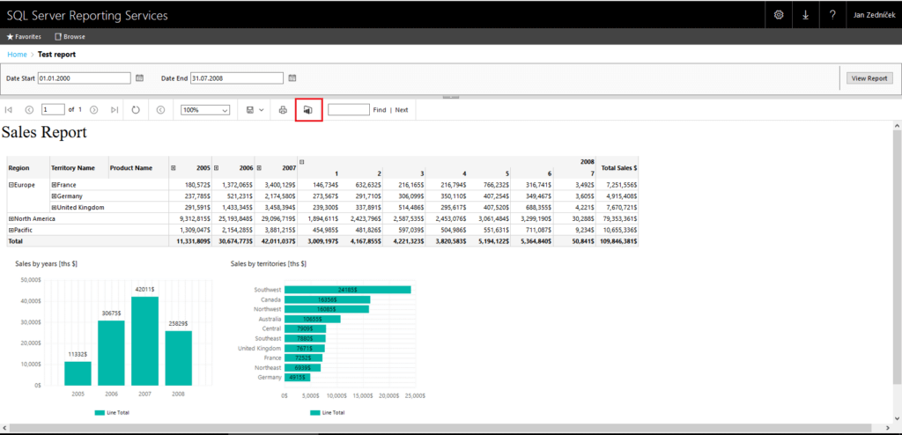
SSRS
SQL Server license
Visual Studio
Limited Data Sources
SQL Server, Oracle, OLE DB, ODBC
https://docs.microsoft.com/en-us/sql/reporting-services/report-data/data-sources-supported-by-reporting-services-ssrs

Slide 14
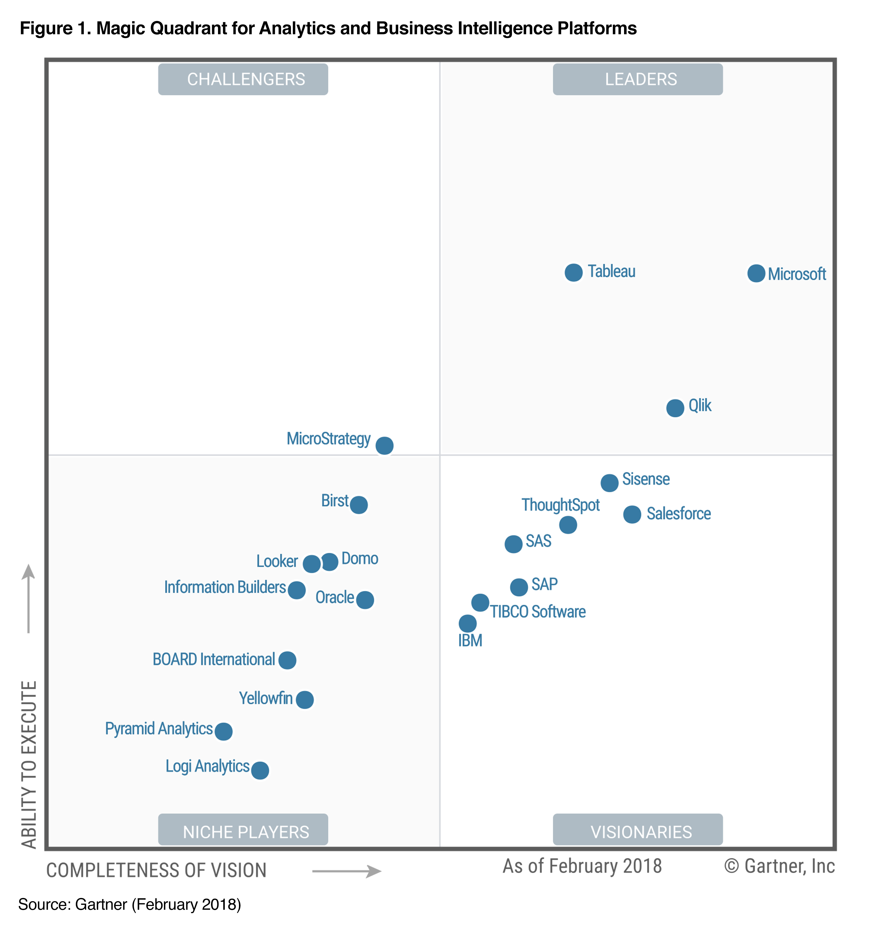
2018 Gartner Magic Quadrant Business Intelligence

Slide 15

QlikView

Slide 16
QlikView - Requirements
https://help.qlik.com/en-US/qlikview/12.1/Content/System-requirements.htm

Slide 17
QlikView – Versions/Pricing
https://www.qlik.com/us/pricing

Slide 18

QlikView - Platforms
https://www.qlik.com/us/products/qlikview

Slide 19

Tableau

Slide 20
Tableau - Requirements
https://www.tableau.com/products/desktop

Slide 21
Tableau – Versions/Pricing
https://www.tableau.com/products/desktop

Slide 22
Tableau - Platforms
https://www.tableau.com/products

Slide 23

Tableau – Nonprofit Benefits
https://www.tableau.com/foundation/license-donations

Slide 24

Power BI

Slide 25
Power BI - Requirements
https://www.microsoft.com/en-us/download/details.aspx?id=45331

Slide 26
Power BI – Data Sources
https://powerbi.microsoft.com/en-us/

Slide 27
Power BI – Versions/Pricing
Nonprofit Discounts available
https://powerbi.microsoft.com/en-us/pricing/

Slide 28

Power BI - Workflow
1 – Get Data
2 – Clean/Transform
3 - Aggregate
4 - Visualizations

Slide 29
Power BI - Resources
Online Book (Free) – Power BI from Rookie to Rock Star
http://radacad.com/online-book-power-bi-from-rookie-to-rockstar
DAX Patterns
https://www.daxpatterns.com/
YouTube – Power BI Jedi
https://www.youtube.com/watch?v=r0Qk5V8dvgg
Microsoft Power BI Blog
https://powerbi.microsoft.com/en-us/blog/

